Slide 1
8051Micro controller

Slide 3
Microprocessors:
General-purpose microprocessor
CPU for Computers
No RAM, ROM, I/O on CPU chip itself
Example：Intel’s x86, Motorola’s 680x0
Many chips on mother’s board
Data Bus
CPU
General-Purpose Micro-processor
I/O Port
Serial COM Port
RAM
ROM
Timer
Address Bus
General-Purpose Microprocessor System
Notes:
Intel’s x86: 8086,8088,80386,80486, Pentium
Motorola’s 680x0: 68000, 68010, 68020,68030,6040

Slide 4
Microcontroller :
A smaller computer
On-chip RAM, ROM, I/O ports...
Example：Motorola’s 6811, Intel’s 8051, Zilog’s Z8 and PIC 16X
CPU
RAM
ROM
A single chip
Serial COM Port
I/O Port
Timer
Microcontroller

Slide 5
Microprocessor vs. Microcontroller
Microprocessor
CPU is stand-alone, RAM, ROM, I/O, timer are separate
designer can decide on the amount of ROM, RAM and I/O ports.
expansive
versatility
general-purpose
Microcontroller
CPU, RAM, ROM, I/O and timer are all on a single chip
fix amount of on-chip ROM, RAM, I/O ports
for applications in which cost, power and space are critical
single-purpose
Notes:
versatility 多用途的: any number of applications for PC

Slide 6
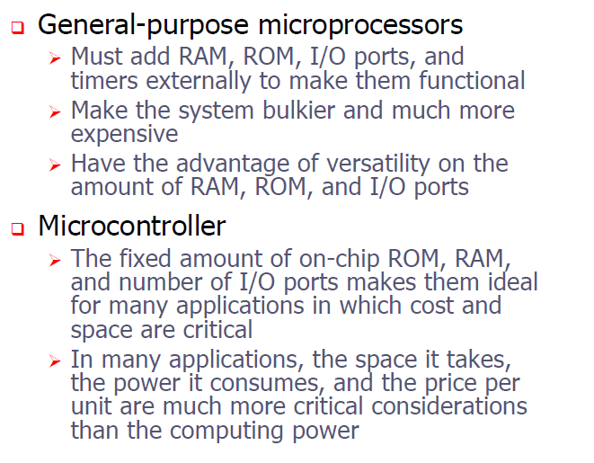

Slide 7
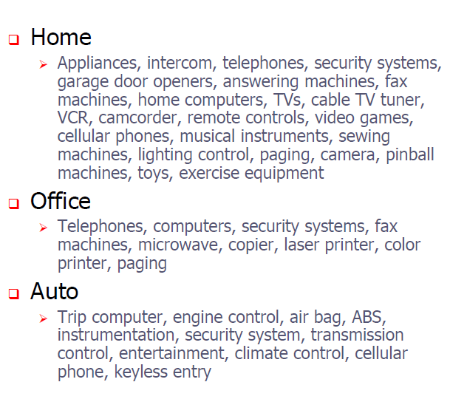

Slide 8
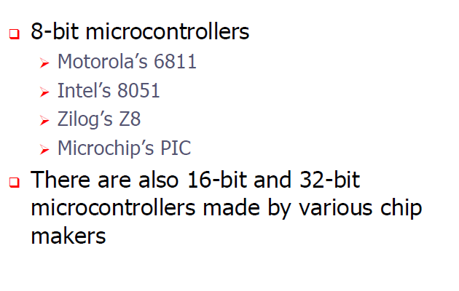

Slide 9
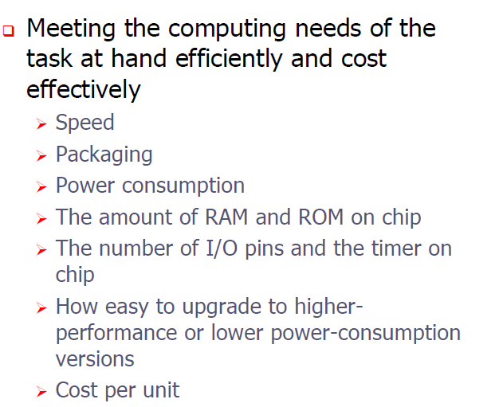
Criteria for choosing micro controller

Slide 10
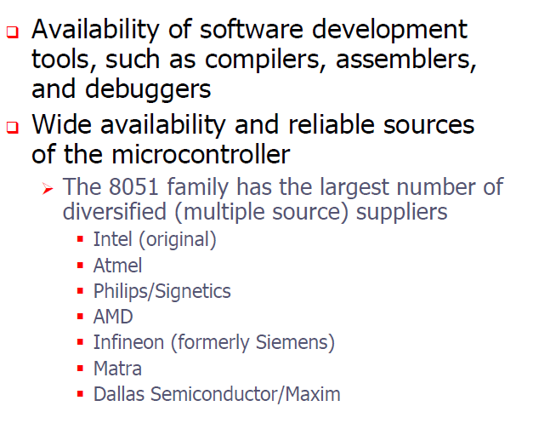

Slide 11
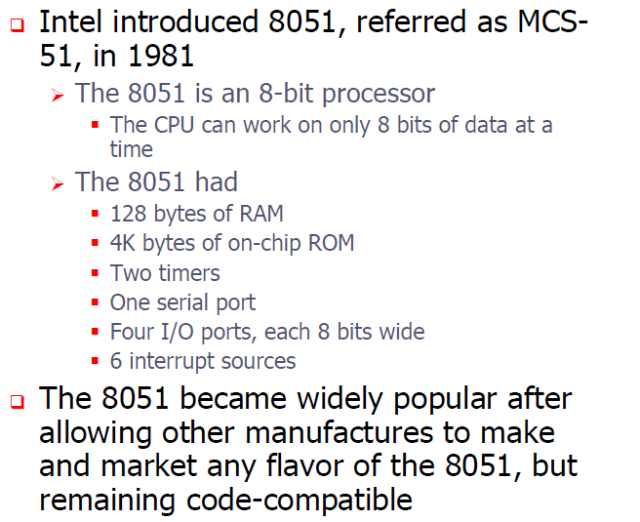
8051

Slide 12
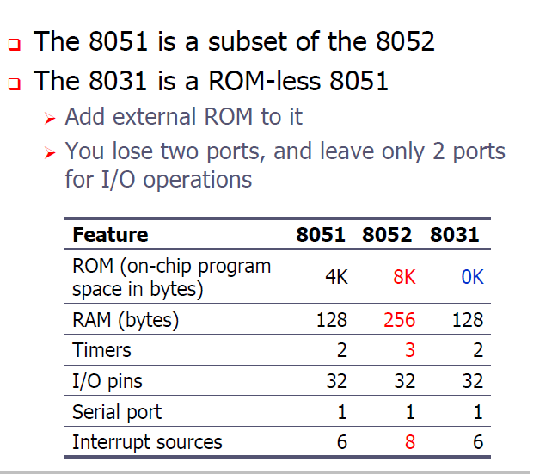

Slide 14

Pin Description of the 8051
P1.0
1
40
Vcc
P1.1
2
39
P0.0(AD0)
P1.2
3
38
P0.1(AD1)
P1.3
4
8051
37
P0.2(AD2)
P1.4
5
36
P0.3(AD3)
P1.5
6
35
P0.4(AD4)
P1.6
7
34
P0.5(AD5)
P1.7
8
33
P0.6(AD6)
RST
9
32
P0.7(AD7)
(RXD)P3.0
10
31
EA/VPP
(TXD)P3.1
11
30
ALE/PROG
(INT0)P3.2
12
29
PSEN
(INT1)P3.3
13
28
P2.7(A15)
(T0)P3.4
14
27
P2.6(A14)
(T1)P3.5
15
26
P2.5(A13)
(WR)P3.6
16
25
P2.4(A12)
(RD)P3.7
17
24
P2.3(A11)
XTAL2
18
23
P2.2(A10)
XTAL1
19
22
P2.1(A9)
GND
20
21
P2.0(A8)


Slide 15
Pins of 8051
Vcc（pin 40）：
Vcc provides supply voltage to the chip.
The voltage source is +5V.
GND（pin 20）：ground
XTAL1 and XTAL2（pins 19,18）：
These 2 pins provide external clock.
Way 1：using a quartz crystal oscillator
Way 2：using a TTL oscillator
Example 4-1 shows the relationship between XTAL and the machine cycle.

Slide 16
XTAL Connection to 8051
Using a quartz crystal oscillator
We can observe the frequency on the XTAL2 pin.
C2
XTAL2
30pF
C1
XTAL1
30pF
GND

Slide 17
Machine cycle
the smallest time to accomplish any simple instruction is called machine cycle
Find the machine cycle for
(a) XTAL = 11.0592 MHz
(b) XTAL = 16 MHz.
Solution:
(a) 11.0592 MHz / 12 = 921.6 kHz;
machine cycle = 1 / 921.6 kHz = 1.085 μs
(b) 16 MHz / 12 = 1.333 MHz;
machine cycle = 1 / 1.333 MHz = 0.75 μs

Slide 18
Pins of 8051（2/4）
RST（pin 9）：reset
It is an input pin and is active high（normally low）.
Upon applying a high pulse to RST, the microcontroller will reset and all values in registers will be lost.

Slide 19
RESET Value of Some 8051 Registers:
Register
Reset Value
PC
0000
ACC
00
B
00
PSW
00
SP
07
DPTR
0000
RAM are all zero


Slide 20
Pins of 8051（3/4）
/EA（pin 31）：external access
The /EA pin is connected to GND to indicate the code is stored externally.
/PSEN（pin 29）：program store enable
This is an output pin and is connected to the OE pin of the ROM

Slide 21
Pins of 8051（4/4）
ALE（pin 30）：address latch enable
It is an output pin and is active high.
8051 port 0 provides both address and data.
The ALE pin is used for de-multiplexing the address and data by connecting to the G pin of the 74LS373 latch.
I/O port pins
The four ports P0, P1, P2, and P3.
Each port uses 8 pins.
All I/O pins are bi-directional.

Slide 22
IMPORTANT PINS (IO Ports)
One of the most useful features of the 8051 is that it contains four I/O ports (P0 - P3)
Port 0 （pins 32-39）：P0（P0.0～P0.7）
8-bit R/W - General Purpose I/O
Or acts as a multiplexed low byte address and data bus for external memory design
Port 1 （pins 1-8） ：P1（P1.0～P1.7）
Only 8-bit R/W - General Purpose I/O
Port 2 （pins 21-28）：P2（P2.0～P2.7）
8-bit R/W - General Purpose I/O
Or high byte of the address bus for external memory design
Port 3 （pins 10-17）：P3（P3.0～P3.7）
General Purpose I/O
if not using any of the internal peripherals (timers) or external interrupts.
Each port can be used as input or output (bi-direction)

Slide 23
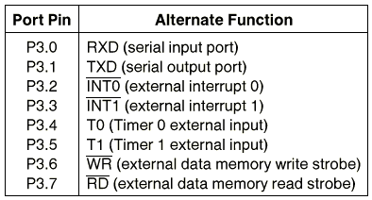
Port 3 Alternate Functions

Slide 24
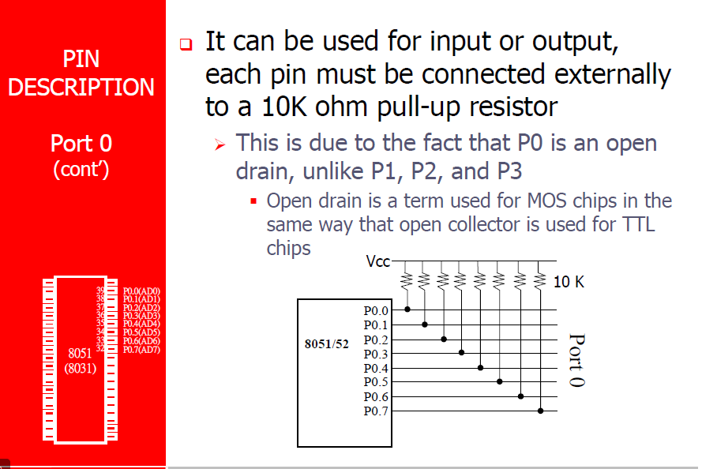

Slide 25
Architecture

Slide 26
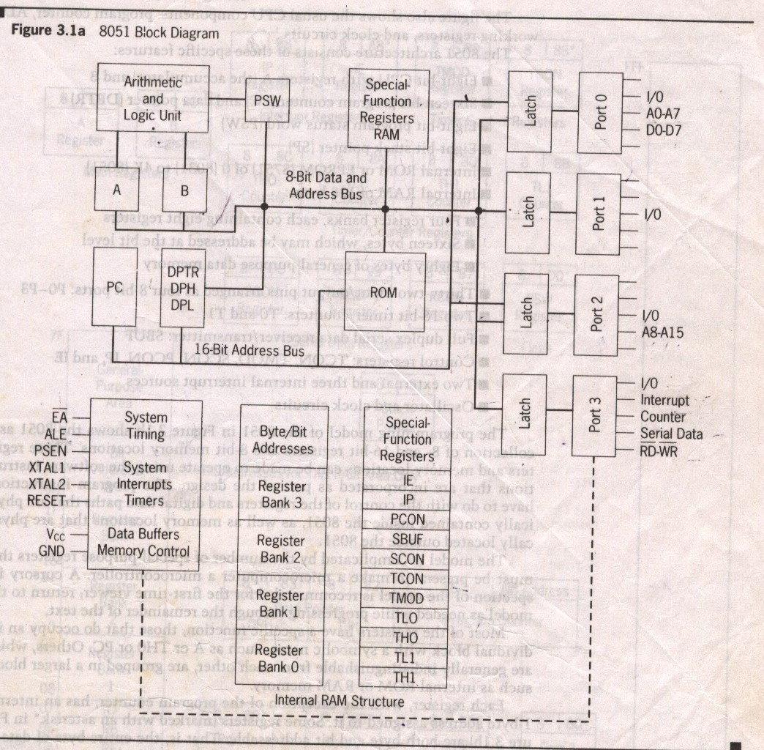
Block Diagram

Slide 27
Program Counter & Data Pointer
They are both 16 bit registers.
Each is to hold the address of a byte in memory
PC contains the address of the next instruction to be executed.
DPTR is made up of two 8 bit register DPH and DPL;
DPTR contains the address of internal & external code and data that has to be accessed.

Slide 28
A and B CPU registers
Totally 34 general purpose registers or working registers.
Two of these A and B hold results of many instructions, particularly math and logical operations of 8051 cpu.
The other 32 are in four banks,B0 – B3 of eight registers each.
A(accumulator) is used for addition,subtraction,mul,div,boolean bit manipulation and for data transfers.
But B register can only be used for mul and div operations.

Slide 29
8051 Flag bits and the PSW register
PSW Register
CY
AC
F0
RS1
RS0
OV
--
P
CY PSW.7 Carry flag
AC PSW.6 Auxiliary carry flag
-- PSW.5 Available to the user for general purpose
RS1 PSW.4 Register Bank selector bit 1
RS0 PSW.3 Register Bank selector bit 0
OV PSW.2 Overflow flag
-- PSW.1 User define bit
P PSW.0 Parity flag Set/Reset odd/even parity
RS1 RS0 Register Bank Address
0 0 0 00H-07H
0 1 1 08H-0FH
1 0 2 10H-17H
1 1 3 18H-1FH

Slide 30
Memory Organization
RAM memory space allocation in the 8051
7FH
Scratch pad RAM
30H
2FH
Bit-Addressable RAM
20H
1FH
Register Bank 3
18H
17H
Register Bank 2
10H
0FH
(Stack) Register Bank 1
08H
07H
Register Bank 0
00H

Slide 31
Stack in the 8051
The register used to access the stack is called SP (stack pointer) register.
The stack pointer in the 8051 is only 8 bits wide, which means that it can take value 00 to FFH. When 8051 powered up, the SP register contains value 07.
7FH
Scratch pad RAM
30H
2FH
Bit-Addressable RAM
20H
1FH
Register Bank 3
18H
17H
Register Bank 2
10H
0FH
(Stack) Register Bank 1
08H
07H
Register Bank 0
00H

Slide 32
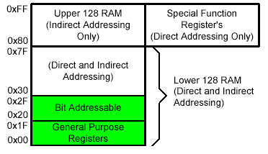
On-Chip Memory Internal RAM

Slide 33
Registers
1F
18
Bank 3
Four Register Banks
Each bank has R0-R7
Selectable by psw.2,3
17
10
Bank 2
0F
08
Bank 1
07
06
05
04
03
02
01
00
R7
R6
R5
R4
R3
R2
R1
R0
Bank 0

Slide 34
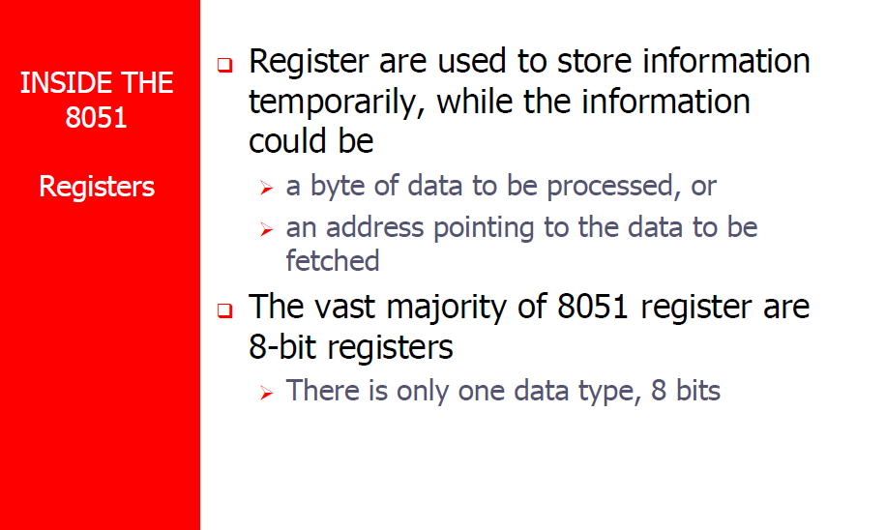

Slide 35
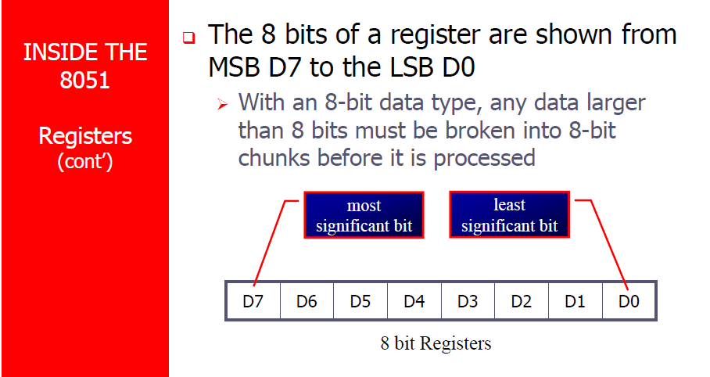

Slide 36
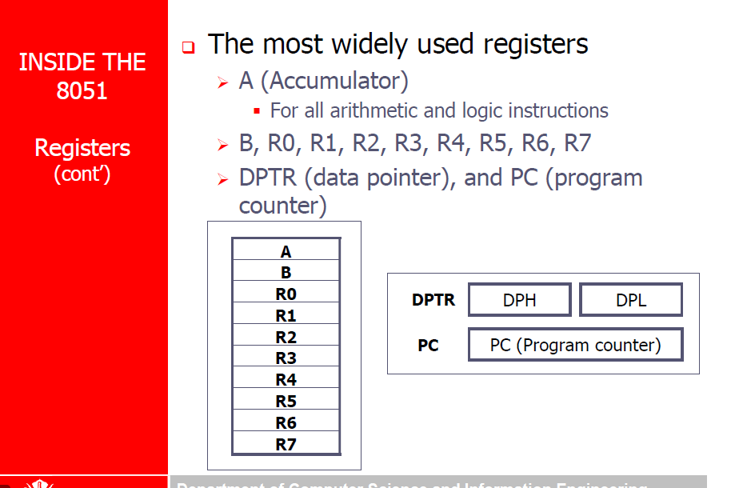

Slide 37
Register Banks
Active bank selected by PSW [RS1,RS0] bit
Permits fast “context switching” in interrupt service routines (ISR).

Slide 38
Bit Addressable Memory
2F
2E
2D
2C
2B
2A
29
28
7F |  |  |  |  |  |  | 78
 |  |  |  |  | 1A
 |  |  |  |  |  |  | 10
0F |  |  |  |  |  |  | 08
07 | 06 | 05 | 04 | 03 | 02 | 01 | 00
20h – 2Fh (16 locations X 8-bits = 128 bits)
Bit addressing:
mov C, 1Ah
or
mov C, 23h.2
27
26
25
24
23
22
21
20

Slide 39
Special Function Registers
DATA registers
CONTROL registers
Timers
Serial ports
Interrupt system
Analog to Digital converter
Digital to Analog converter
Etc.
Addresses 80h – FFh
Direct Addressing used to access SPRs

Slide 40
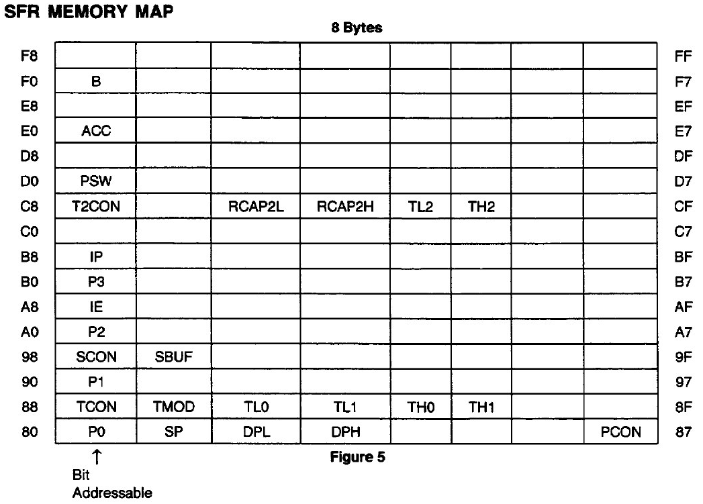
SFR Memory:

Slide 41
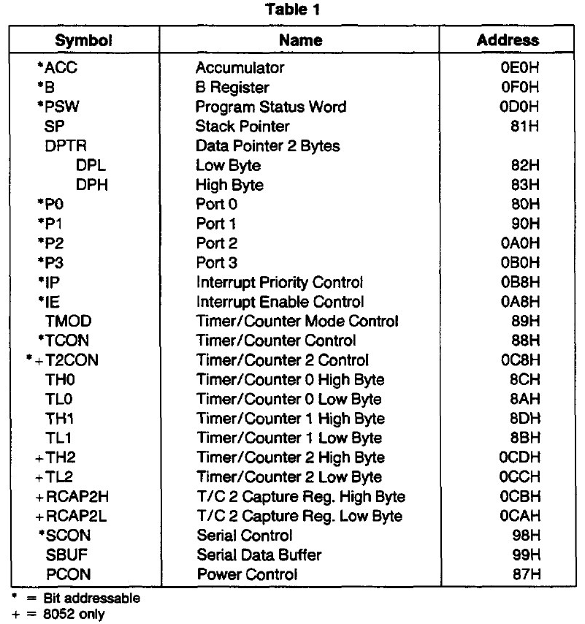
Addresses of Registers :

Slide 42
Programming model

Slide 43
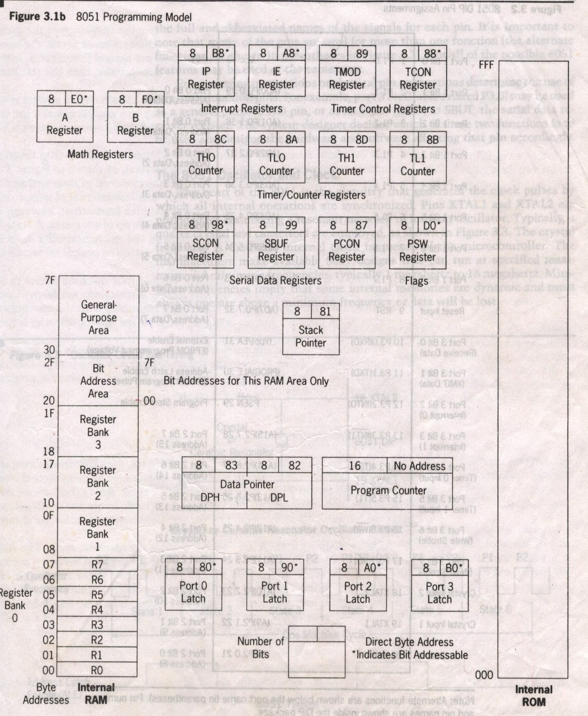
8051 Programming Model

Slide 44
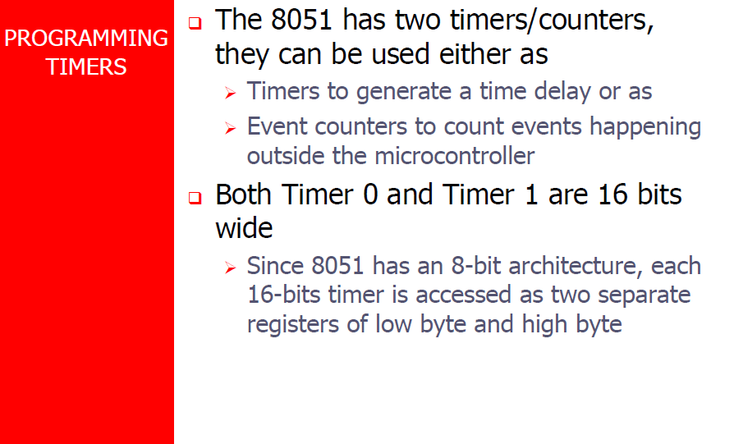

Slide 45
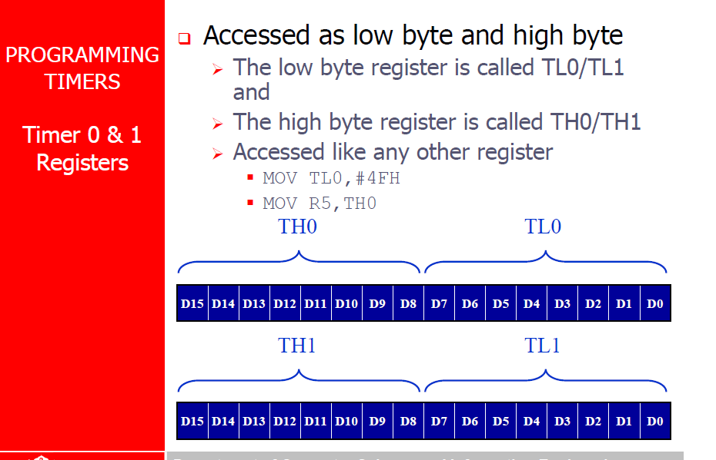

Slide 46
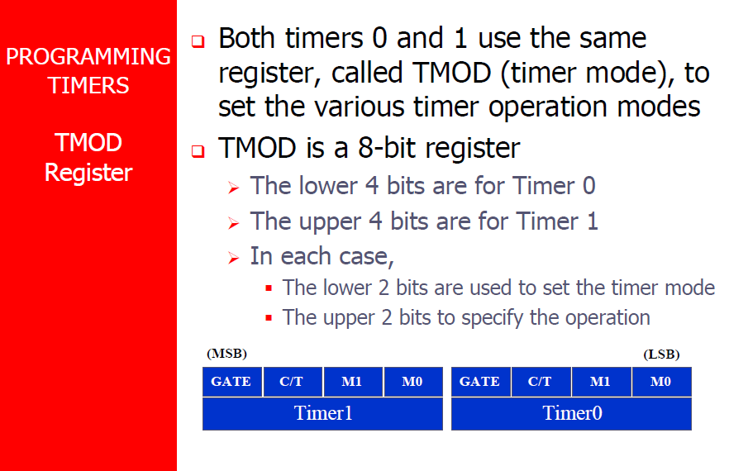

Slide 47
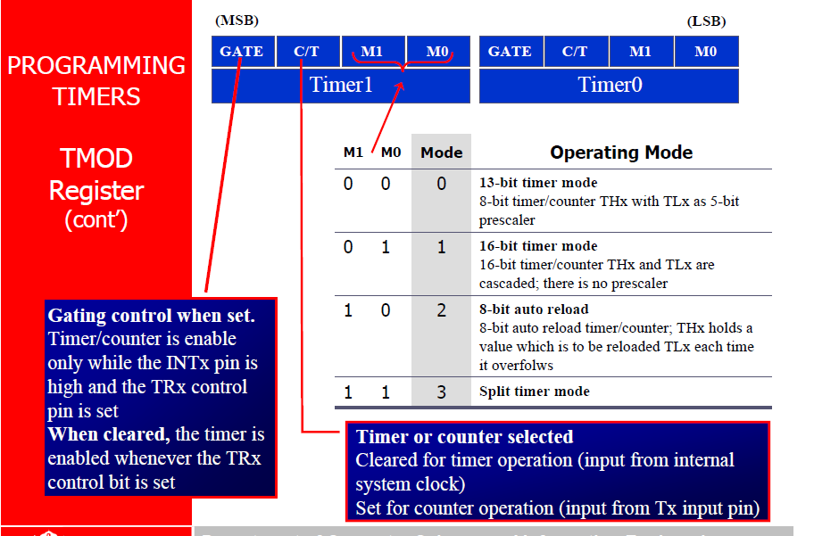

Slide 48
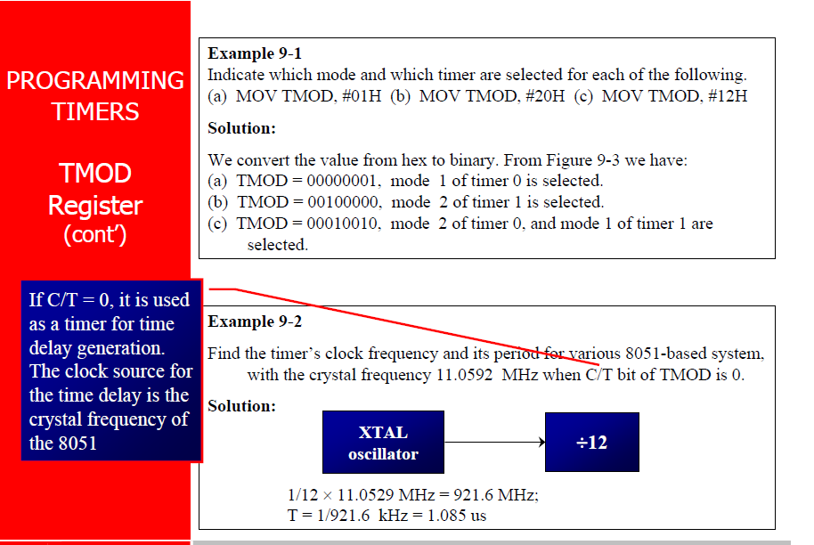

Slide 49
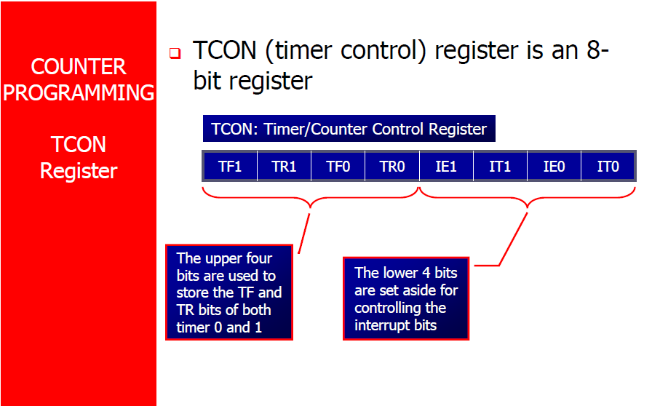

Slide 50
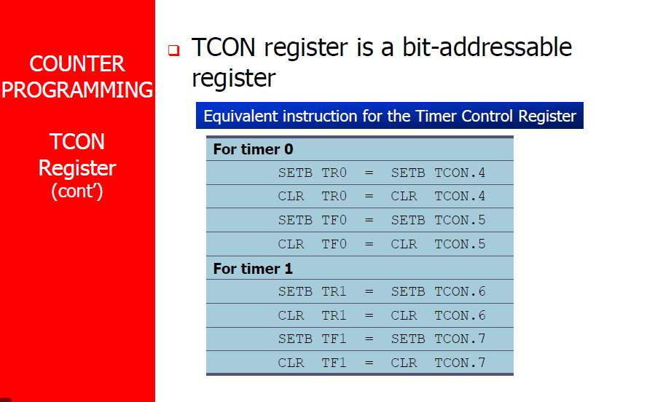

Slide 51
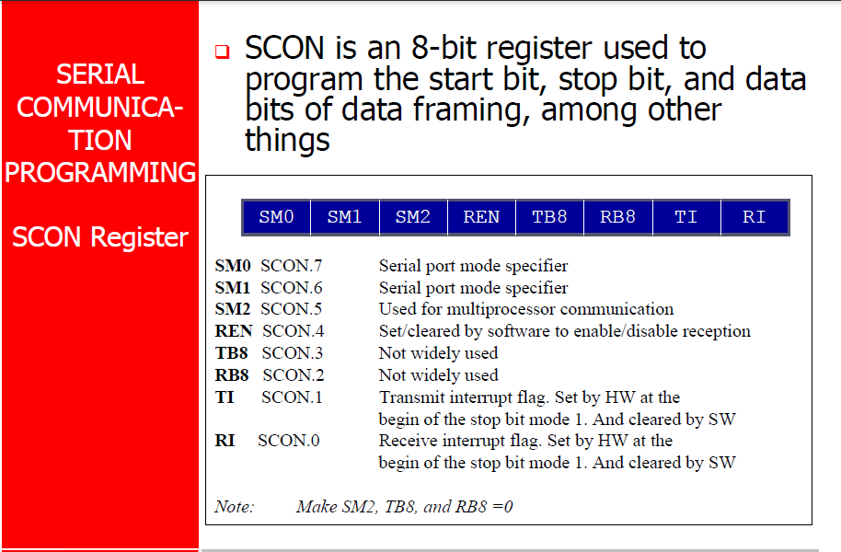

Slide 52
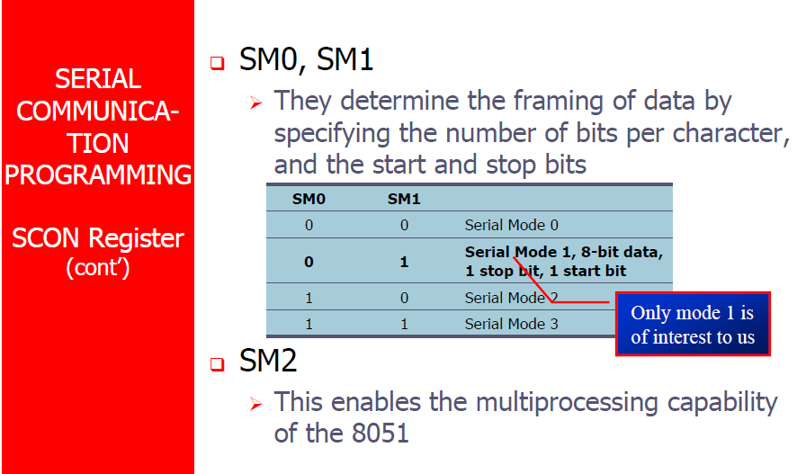

Slide 53
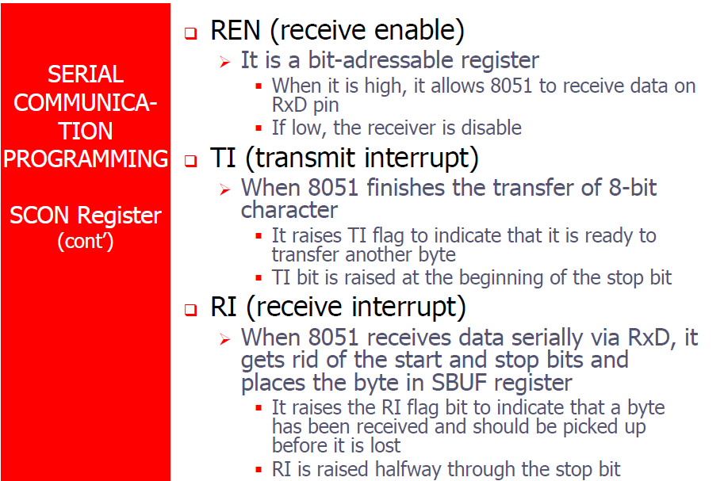

Slide 54
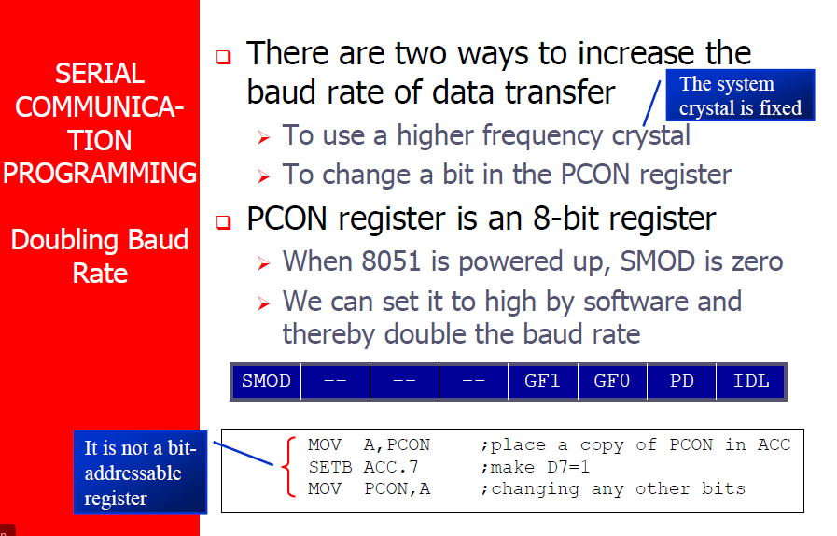

Slide 55
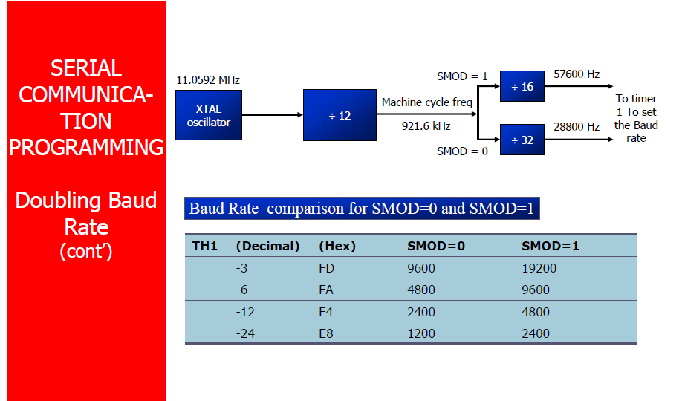

Slide 56
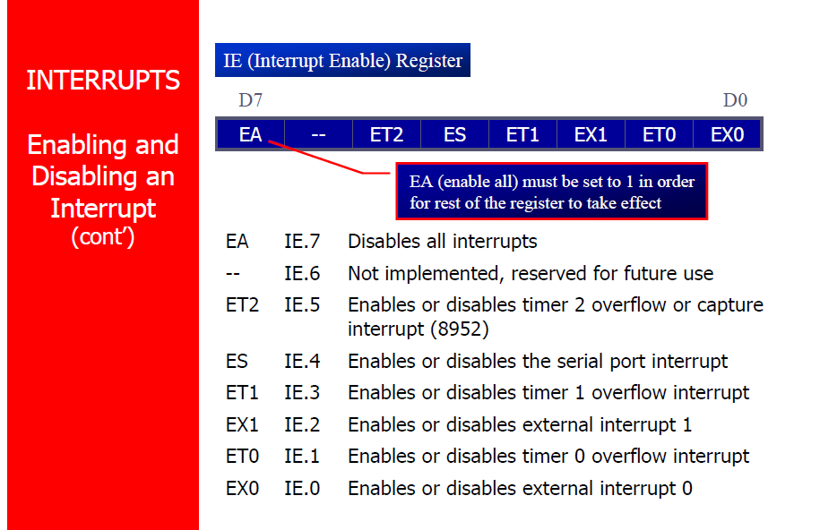

Slide 57
